Slide 1
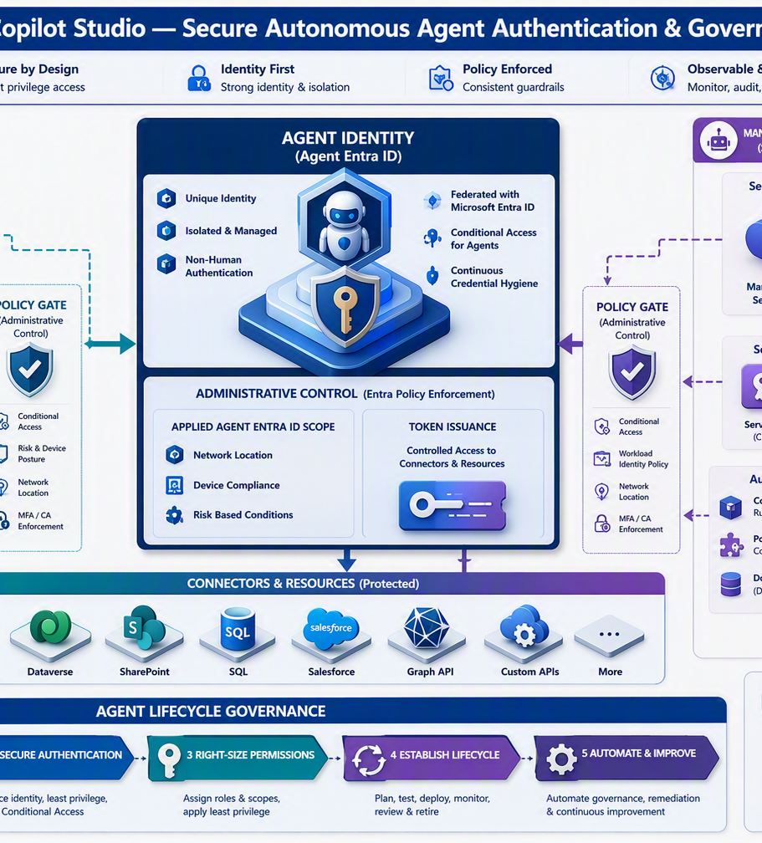
COPILOT STUDIO
Agent Lifecycle, Agent Entra Identity Governance Framework and AI Model Lifecycle
A practical operating framework for agent lifecycle, secure autonomous authentication, controlled deployment and governance of Entra ID and options for AI model upgrade and Lifecycle.
Identity-first
Lifecycle-managed
Policy-enforced
Observable
By: Isha Kapoor
Notes:
[Sources]
- Concepts synthesized from the user-provided reference slides.
- Visual on this slide was generated with Microsoft Copilot.
[/Sources]

Slide 2

What Happens After an Agent goes into Production…
Notes:
[Sources]
- Concepts synthesized from the user-provided reference slides.
- Visual on this slide was generated with Microsoft Copilot.
[/Sources]

Slide 3
COPILOT STUDIO
Agent Lifecycle, Agent Entra Identity Governance Framework and AI Model Lifecycle
A practical operating framework for agent lifecycle, Deployment, Rollback, Quarantine and Decommissioning.
Identity-first
Lifecycle-managed
Model-upgrade
Observable
By: Isha Kapoor
Notes:
[Sources]
- Concepts synthesized from the user-provided reference slides.
- Visual on this slide was generated with Microsoft Copilot.
[/Sources]

Slide 4
COPILOT STUDIO | ENTERPRISE GOVERNANCE
Agent Lifecycle: generic view
Agent move through different stages and needs to operate
1
2
3
4
5
Discover
Secure
Deliver
Operate
Retire
Inventory agents, owners, environments, dependencies
Bind identity, authentication method, roles and scopes
Promote managed solutions through controlled rings
Monitor health, access, usage, risk and model quality
Revoke access, remove packages, retain evidence
GOVERNANCE OUTCOME
Every agent has a known owner, bounded permissions, controlled promotion path, measurable health, and an auditable exit.
Isha Kapoor | Copilot Studio Lifecycle & Agent Governance
02
Notes:
[Sources]
- Concepts synthesized from the user-provided reference slides.
[/Sources]

Slide 5
COPILOT STUDIO | ENTERPRISE GOVERNANCE
Deployment path: promote with control
DEV
QA
PROD
Unmanaged solution
Managed solution
Managed solution
APPROVE
SIGN-OFF
Maker builds and configures agent
Import through pipeline
Release after approval
Security and sharing policy
Validate functionality and integration
Assign production access group
Key control: identity, solution package, access group, and change record move together as one release unit.
Isha Kapoor | Copilot Studio Lifecycle & Agent Governance
07
Notes:
[Sources]
- Concepts synthesized from the deployment process slide provided by the user.
[/Sources]

Slide 6
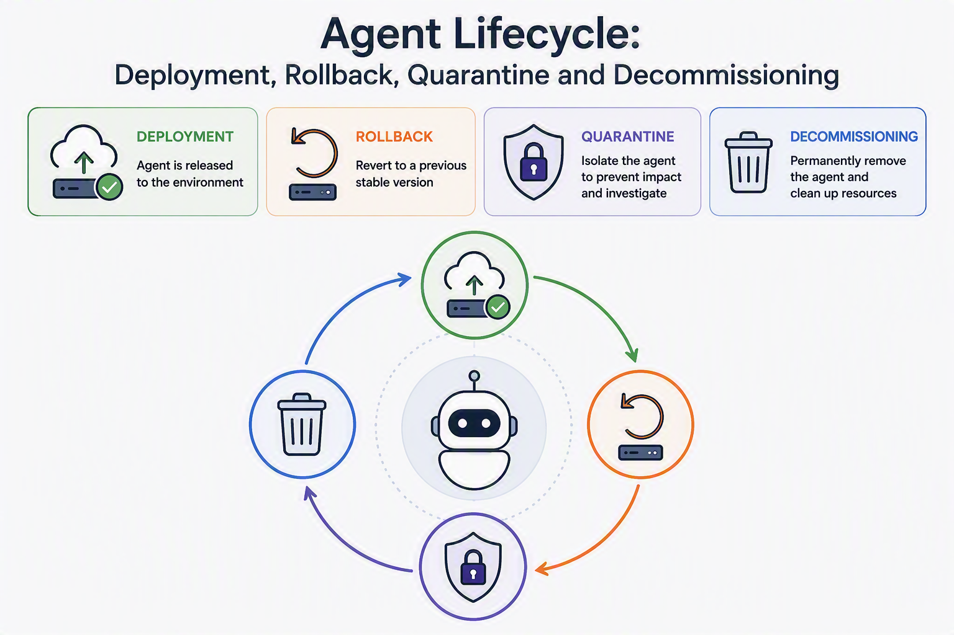
COPILOT STUDIO | ENTERPRISE GOVERNANCE
Agent Lifecycle: Deployment, Rollback, Quarantine and Decommissioning
Key control: identity, solution package, access group, and change record move together as one release unit.
Isha Kapoor | Copilot Studio Lifecycle & Agent Governance
07
Notes:
[Sources]
- Concepts synthesized from the deployment process slide provided by the user.
[/Sources]

Slide 7
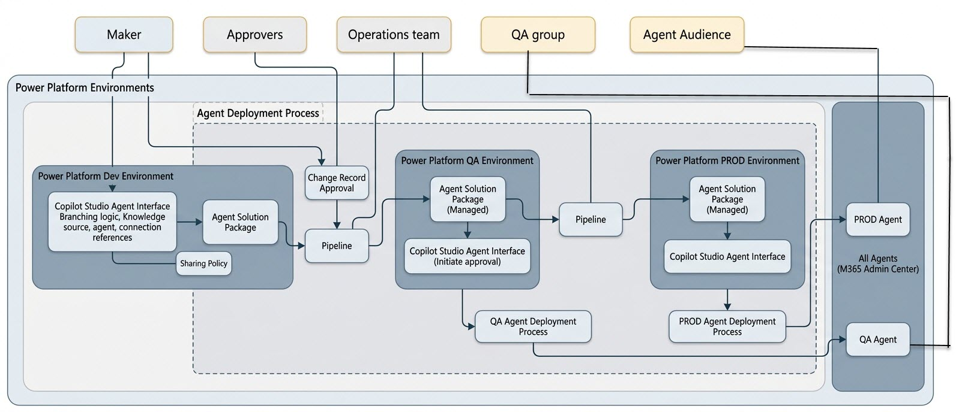
COPILOT STUDIO | ENTERPRISE GOVERNANCE
Agent Lifecycle: Deployment
Isha Kapoor | Copilot Studio Lifecycle & Agent Governance
07
Notes:
[Sources]
- Concepts synthesized from the deployment process slide provided by the user.
[/Sources]

Slide 8
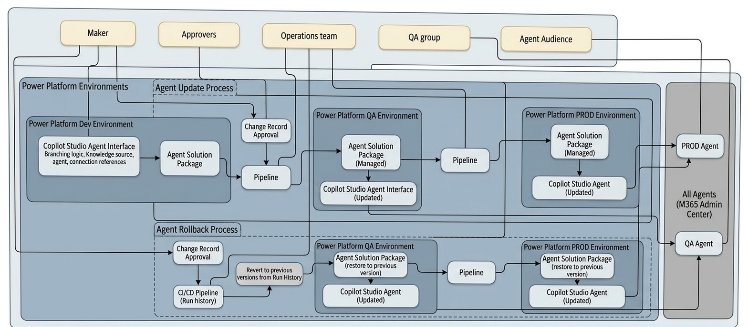
COPILOT STUDIO | ENTERPRISE GOVERNANCE
Agent Lifecycle: Update & Rollback
Isha Kapoor | Copilot Studio Agent Governance
07
Notes:
[Sources]
- Concepts synthesized from the deployment process slide provided by the user.
[/Sources]

Slide 9
COPILOT STUDIO | ENTERPRISE GOVERNANCE
Update and rollback: two paths, one decision record
NORMAL UPDATE
Modify in DEV
Approve change
Deploy to QA
Validate
Promote to PROD
Monitor
ROLLBACK PATH
Trigger rollback decision
Select prior pipeline run
Restore QA version
Revalidate
Promote prior version
Confirm recovery
Rollback entry criteria
Security issue • failed validation • material quality regression • broken dependency • unacceptable operational risk
Isha Kapoor | Copilot Studio Lifecycle & Agent Governance
08
Notes:
[Sources]
- Concepts synthesized from the update and rollback process slide provided by the user.
[/Sources]

Slide 10
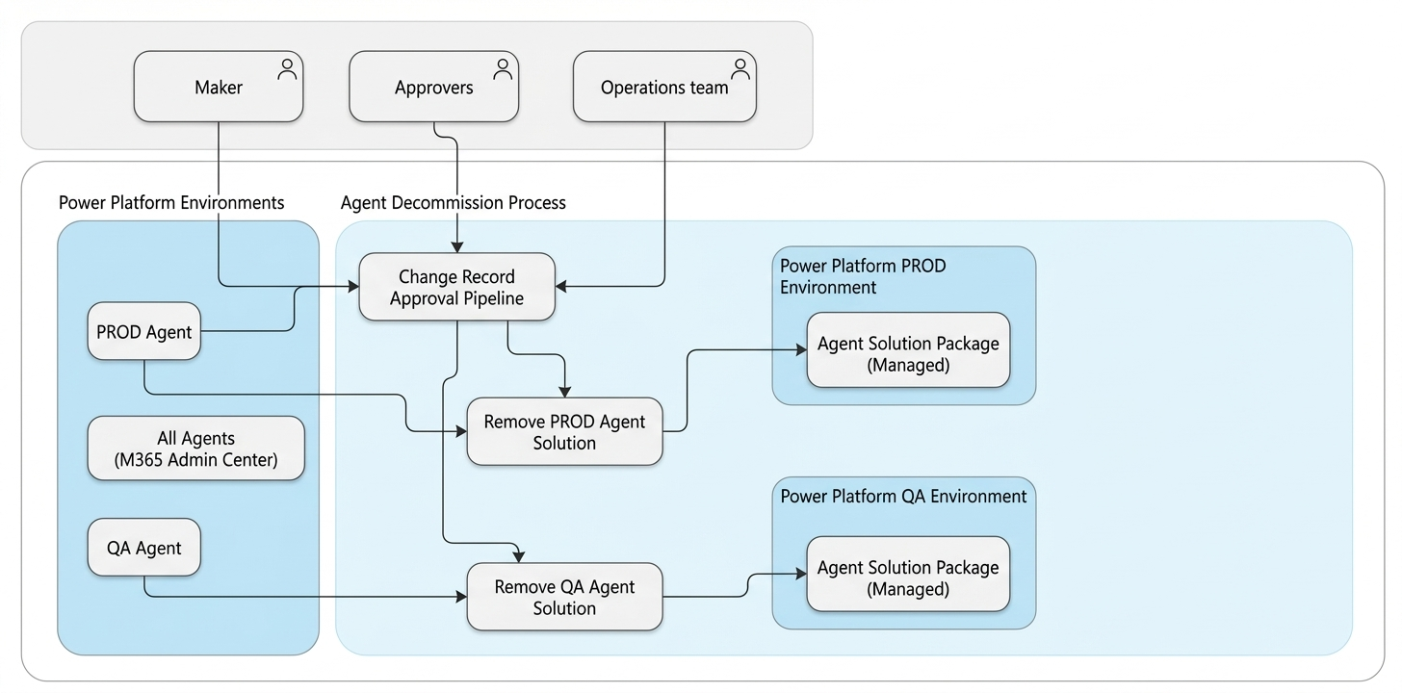
COPILOT STUDIO | ENTERPRISE GOVERNANCE
Agent Lifecycle: Decommission
Isha Kapoor | Copilot Studio Lifecycle & Agent Governance
07
Notes:
[Sources]
- Concepts synthesized from the deployment process slide provided by the user.
[/Sources]

Slide 11
COPILOT STUDIO
Agent Lifecycle, Agent Entra Identity Governance Framework and AI Model Lifecycle
An Agent’s Entra Identity framework for managing Identity Lifecycle and monitoring access permissioned on an Agent’s ID.
Identity-first
Lifecycle-managed
Model-upgrade
Observable
By: Isha Kapoor
Notes:
[Sources]
- Concepts synthesized from the user-provided reference slides.
- Visual on this slide was generated with Microsoft Copilot.
[/Sources]

Slide 12
COPILOT STUDIO | ENTERPRISE GOVERNANCE
Agent Identity Governance Framework
Discover & inventory
Posture & least privilege
Naming, ownership, dependencies
Roles, scopes, credential hygiene
AGENT ID REGISTRY
Owner
Business unit
Environment
Workload
Entra object ID
Authentication pattern
Detect & respond
Lifecycle assurance
Monitoring, alerts, de-provisioning
Attestation, upgrades, stale identity review
Isha Kapoor | Copilot Studio Agent Governance
03
Notes:
[Sources]
- Concepts synthesized from “Agent Identity Governance Framework” in the user-provided slides.
[/Sources]

Slide 13
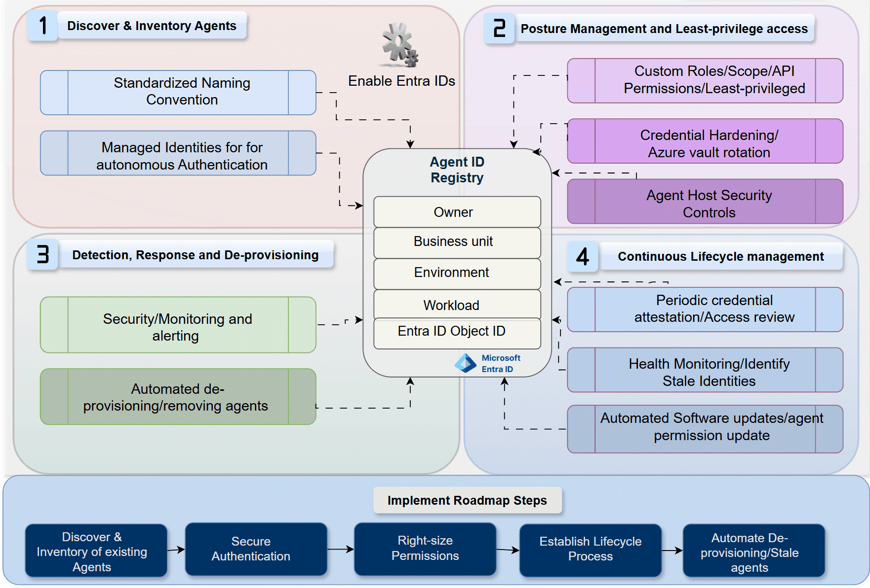
COPILOT STUDIO | ENTERPRISE GOVERNANCE
Agent Identity Governance Framework
The registry is the authoritative control point that connects technical identity to business accountability.
Isha Kapoor | Copilot Studio Agent Governance
03
Notes:
[Sources]
- Concepts synthesized from “Agent Identity Governance Framework” in the user-provided slides.
[/Sources]

Slide 14

COPILOT STUDIO | ENTERPRISE GOVERNANCE
Agent Identity Governance Framework: Identity and access
Human-initiated access
Agent identity
User signs in; agent acts within delegated user context.
Unique Entra-backed identity isolates the agent from maker credentials.
Autonomous access
Policy gate
Managed identity or service account executes event-based work.
Conditional access, device/network posture, scopes and runtime policy.
Design principle
Never use a maker credential for running autonomous triggers.
Isha Kapoor | Copilot Studio Agent Governance
04
Notes:
[Sources]
- Concepts synthesized from the OBO and service-account authentication slides provided by the user.
- Visual on this slide was generated with Microsoft Copilot.
[/Sources]

Slide 15
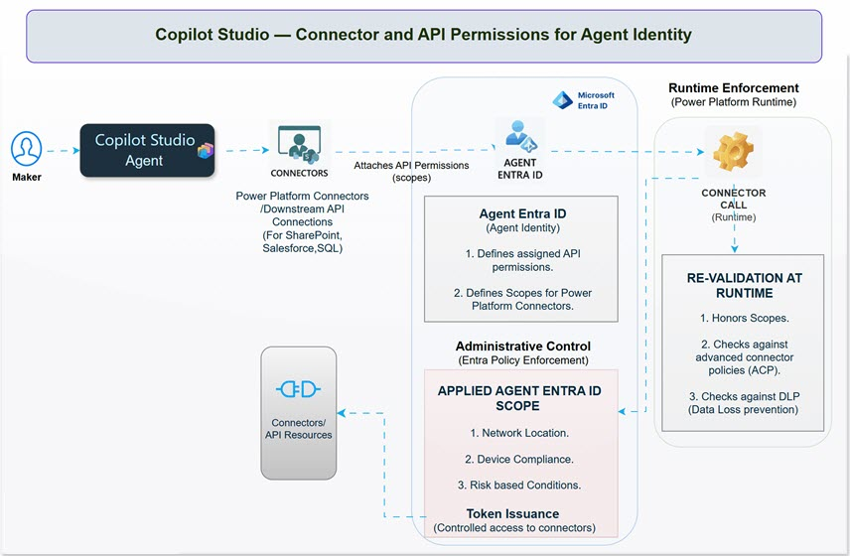
COPILOT STUDIO | ENTERPRISE GOVERNANCE
Agent Identity Governance Framework
Isha Kapoor | Copilot Studio Agent Governance
03
Notes:
[Sources]
- Concepts synthesized from “Agent Identity Governance Framework” in the user-provided slides.
[/Sources]

Slide 16
COPILOT STUDIO
Agent Lifecycle, Agent Entra Identity Governance Framework and AI Model Lifecycle
For your agent’s model is expiring or you are a model or two behind or are considering combining models for cost design constraint or an upgrade to a better reasoning model, the AI Model Lifecycle guides you through a continuous loop to be followed.
Identity-first
Lifecycle-managed
Model-upgrade
Observable
By: Isha Kapoor
Notes:
[Sources]
- Concepts synthesized from the user-provided reference slides.
- Visual on this slide was generated with Microsoft Copilot.
[/Sources]

Slide 17

COPILOT STUDIO | ENTERPRISE GOVERNANCE
AI Model Lifecycle management: Plan, Upgrade and Promote
PLAN
Define version strategy, deployment rings, rollback criteria
EVALUATE
Test configuration, speed, requirements and response quality
PROMOTE
Activate through controlled environments with approvals
MONITOR
Track KPIs, user feedback, access, health and risk
DECIDE
Maintain, upgrade, roll back, or retire
Isha Kapoor | Copilot Studio Agent Governance
06
Notes:
[Sources]
- Concepts synthesized from the AI model lifecycle slide provided by the user.
- Visual on this slide was generated with Microsoft Copilot.
[/Sources]

Slide 18
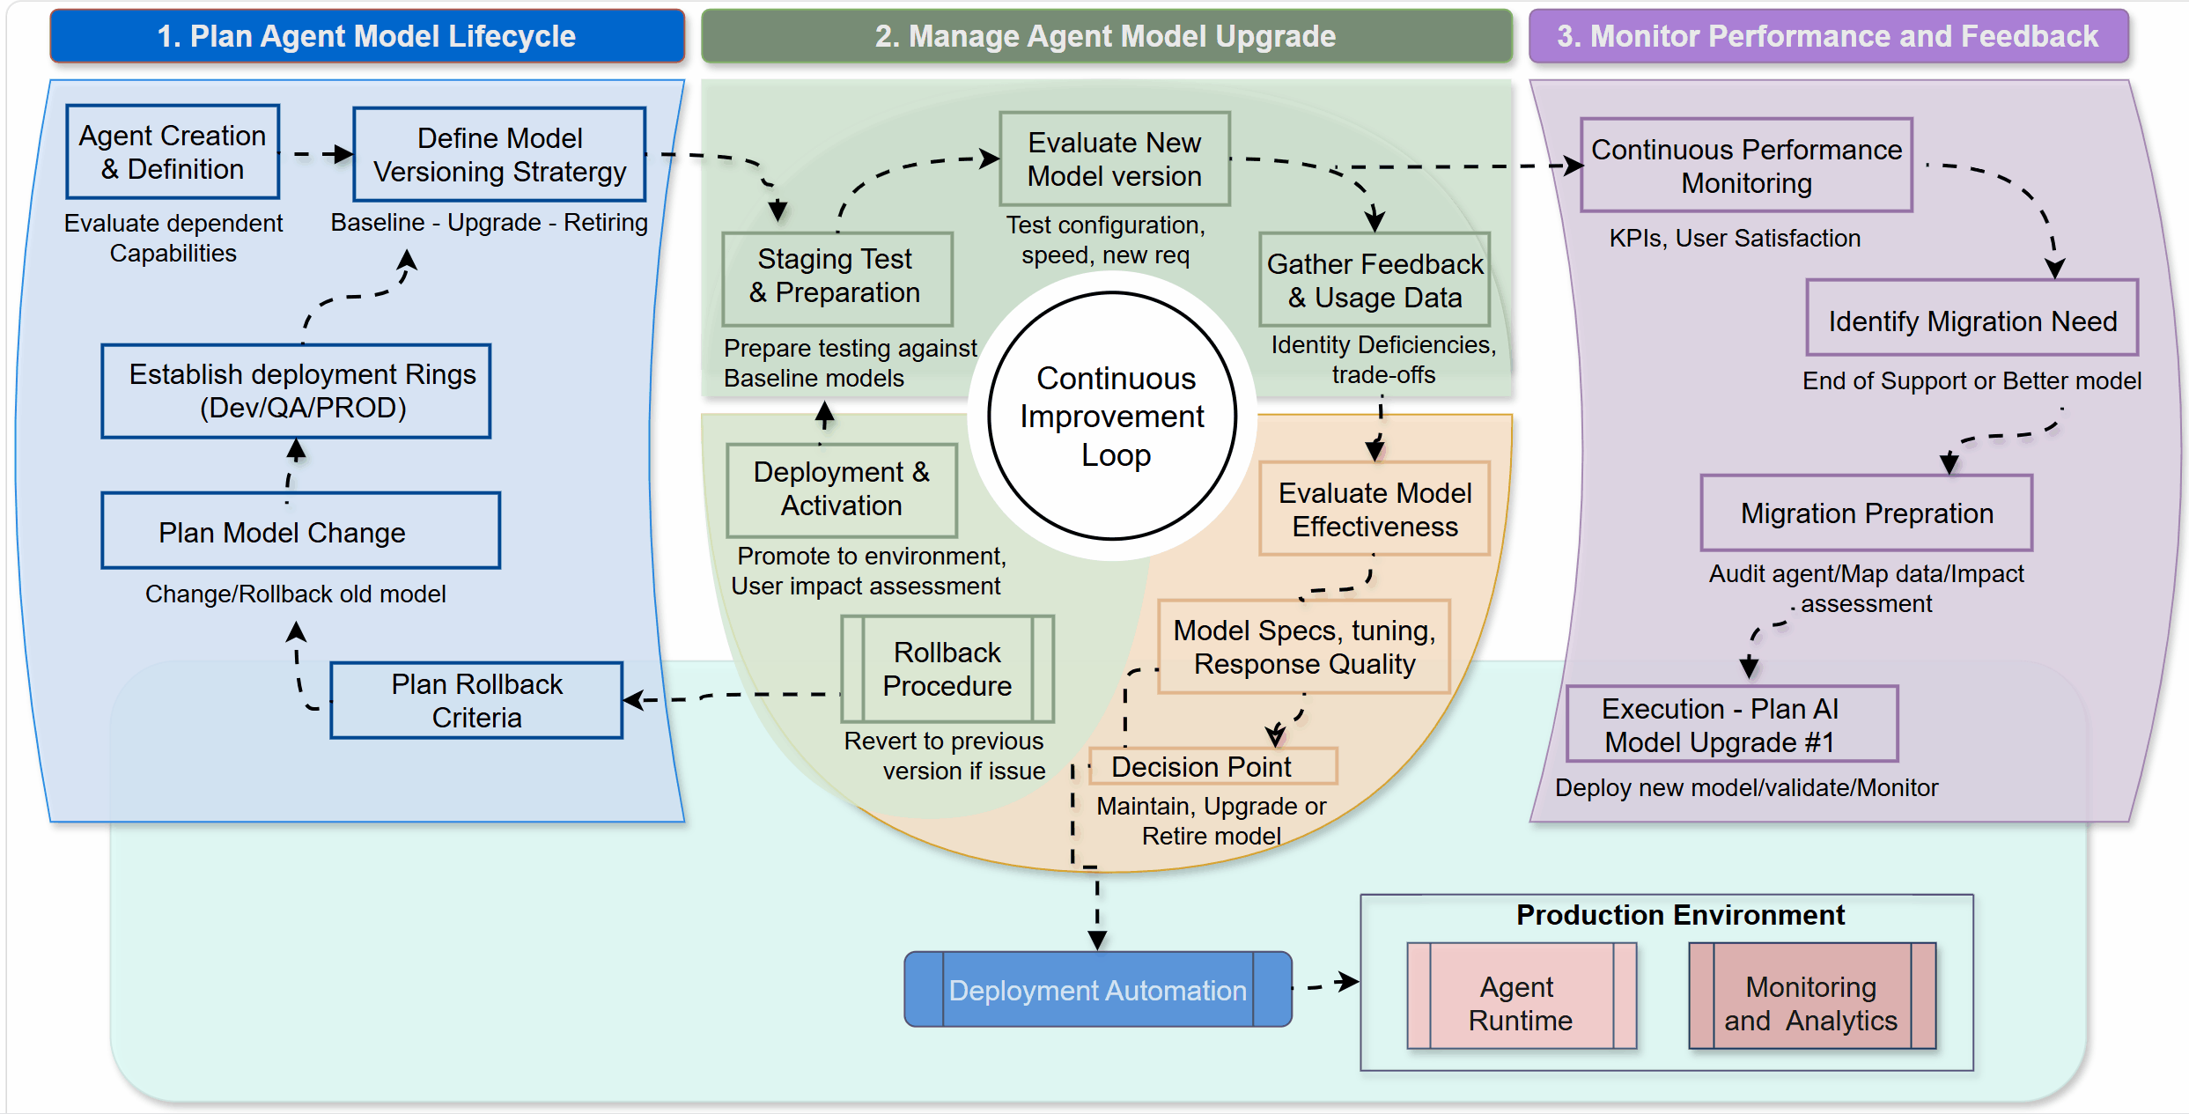
COPILOT STUDIO | ENTERPRISE GOVERNANCE
AI Model Lifecycle management: Plan, Upgrade and Promote
Isha Kapoor | Copilot Studio Lifecycle & Agent Governance
03
Notes:
[Sources]
- Concepts synthesized from “Agent Identity Governance Framework” in the user-provided slides.
[/Sources]

Slide 19
COPILOT STUDIO | ENTERPRISE GOVERNANCE
Implementation roadmap: establish control, then automate
0–30
31–60
61–90
90+
Baseline
Standardize
Operationalize
Optimize
Inventory agents and owners
Define naming and registry fields
Classify authentication patterns
Create role/scope patterns
Formalize DEV–QA–PROD gates
Define monitoring evidence
Launch attestations and reviews
Automate stale identity detection
Test rollback and retirement
Policy-as-code and auto-remediation
Trend quality and risk
Continuously refine controls
Isha Kapoor | Copilot Studio Agent Governance
11
Notes:
[Sources]
- Roadmap synthesized from the user-provided reference slides.
[/Sources]

